Slide 1
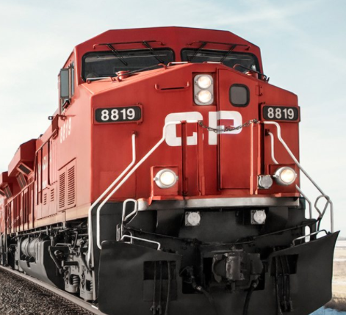

OBRS Cloud Physics Research Program “Kick-off” Meeting
July 22, 2021 (virtual)

Slide 2
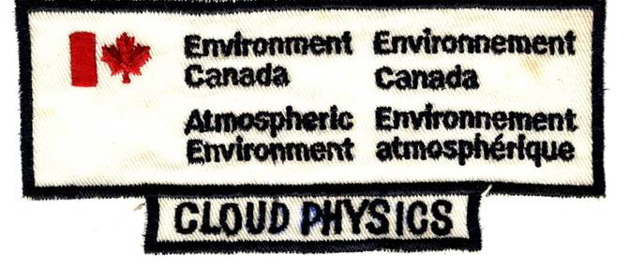

High Impact Weather Research Cloud Physics Research Program “Kick-off” Meeting – TAKE 2
January 21, 2025 (virtual)

Slide 3
AGENDA
Introductory comments
Cloud Physics research program overview document
Individual presentations -- who is doing what
Discussion of future meeting format
Post-meeting comments added (in this font)

Slide 4
Departmental Mandate
ECCC’s core responsibility is to “monitor weather, [...] provide forecasts, information and warnings to the Canadian public, [...] conduct research, develop and maintain computer-based models for predicting weather, and collaborate [...] with other national meteorological services and with international organizations”
(2021-22 ECCC Departmental Plan)

Slide 5
HIWR Function Mapping across Delivery on Mandate for MRD/ASTD: Flowchart of activities

Slide 6
HIWR Function Mapping across Delivery on Mandate for MRD/ASTD: Research activities
HIWR Scientific Research
Aircraft
research program
Radar
research program
Cloud Physics
research program
Nowcasting/HIW
research program
Deliverables:
Policy and regulations
Knowledge of weather and hazards for products and services
NOTE: Any given HIWR project should fall into 1 or more of the 4 research programs

Slide 7

HIWR Function Mapping across Delivery on Mandate for MRD/ASTD: Research activities
Alternative view
MISSING:
Links to CCCMA and AQRD
HIWR Scientific Research
Cloud Physics program
Nowcasting/HIW program
Cloud/precipitation microphysics;
Atmospheric radiative transfer
0-6 h forecasting (includes monitoring);
post-processing
Emphasis on high-impact weather
Measurements
Fundamental research
Representation in models
monitoring and
predicting weather
Observations
1. Ground-based
Radar program
Other remote sensing (e.g. lidar)
In situ (e.g. distrometer)
2. Aircraft Program
3. Space-based
Policy
NWP
(RPN/CCMEP)
predicting weather
Validation of
remote sensing

Slide 8
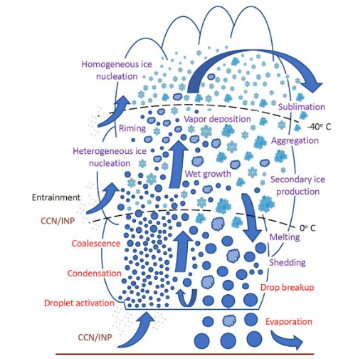
HIWR Function Mapping across Delivery on Mandate for MRD/ASTD: Research activities
Alternative view
HIWR Scientific Research
Solar radiation
Cloud Physics program
Cloud/precipitation microphysics;
Atmospheric radiative transfer
Main Themes* of CP Program:
1. Measurements of clouds/precipitation/radiation using specialized instruments
2. Advancing the understanding of fundamental cloud physics
3. Improvement to the representation of radiation and grid-scale clouds in numerical models
Infrared radiation
* subject to discussion
Discussed and agreed

Slide 9
CP MEETING SERIES
OBJECTIVES:
1. To solidify this HIWR research program; i.e. to define, over time, its roles within MRD (and how the program delivers on mandate).
2. To provide a forum to keep us sufficiently updated on others’ research (in order to maximize potential collaboration, etc.).

Slide 10
CP MEETING SERIES
OBJECTIVES:
1. To solidify this HIWR research program; i.e. to define, over time, its roles within MRD (and how the program delivers on mandate).
2. To provide a forum to keep us sufficiently updated on others’ research (in order to maximize potential collaboration, etc.).
PROPOSED MEETING ITEMS/TOPICS:
1. Complete the CP program Overview document (this is an ad hoc action item)
2. Short (5-20 min) update presentations on individuals’ research project(s) – when it makes sense
3. Mini seminars (30 min) on a specific CP topic (e.g. a summary presentation of a published article)

Slide 11
AGENDA
Introductory comments
Cloud Physics research program overview document
Individual presentations -- who is doing what
Discussion of future meeting format

Slide 12
Cloud Physics research program OVERVIEW DOCUMENT
1. PURPOSE of document
- to define clearly the objectives and research activities of the CP research program (for our own clarity)
- to communicate concisely to others (esp. upper management) the objectives of the program (and how it delivers on mandate)
2. INTENDED AUDIENCE
- us (HIWR), CP researchers and section at large
- our MRD director
- eventually: other sections in MRD or CCMEP
THOUGHTS:
- perhaps this document could be 1) simplified into a “2-pager” (for quick consumption) and 2) expanded into a dynamic on-line “document” (website/wiki page), thereby allowing for expansion of project details as well as updates
Discussed: It was agreed that a “written” 2-pager will be useful (e.g. for management) but that it should not be a workplan; details of specific projects should be put on an dynamic expansion of this (e.g. website, wiki, GitLab)

Slide 13
AGENDA
Introductory comments
Cloud Physics research program overview document
Individual presentations -- who is doing what
Discussion of future meeting format

Slide 14
UPDATE 1: Jason Milbrandt
Assumptions (Premises)
bulk microphysics schemes will play in increasingly important role in NWP and atmospheric research in ECCC (and elsewhere) for years to come (well after I retire); AI will change their roles but not replace them (at least, not soon)
I am (unapologetically) P3-centric
filling gaps in the P3 microphysics scheme fits well within the CP program

Slide 15
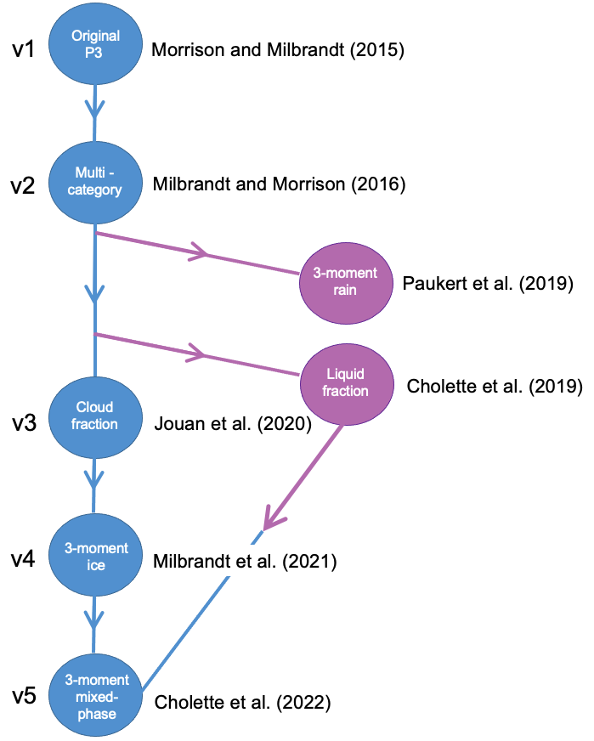
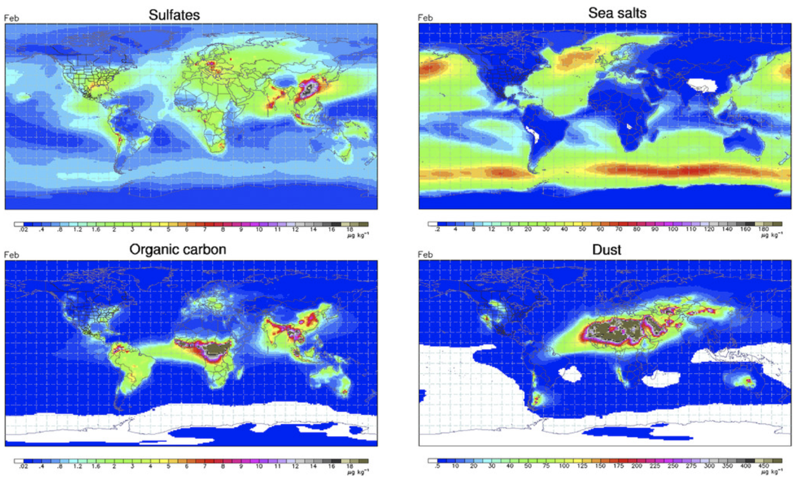
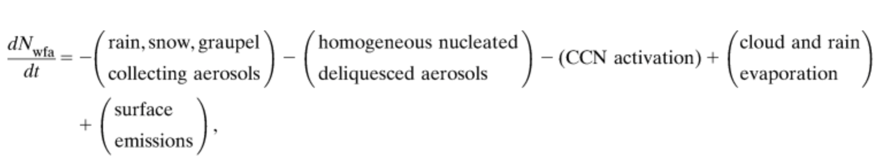
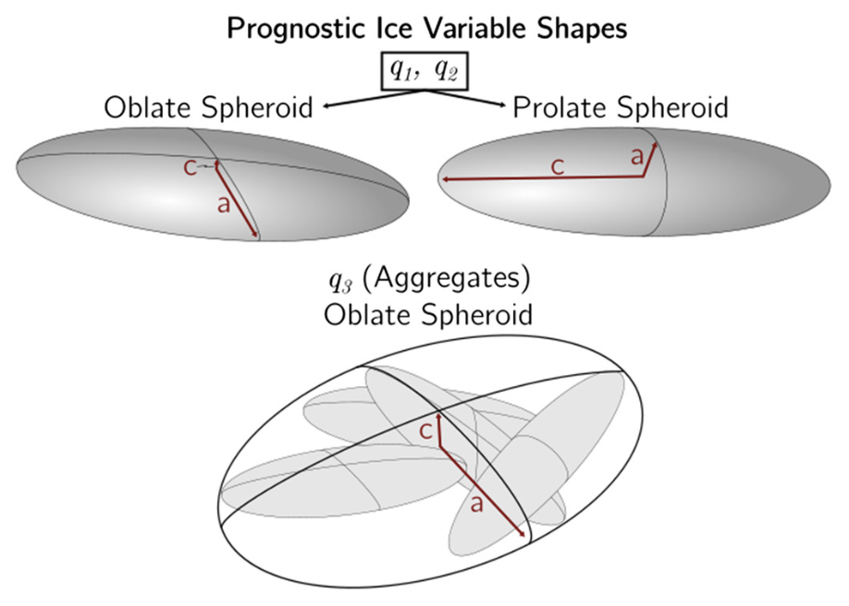
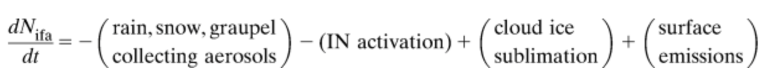
UPDATE 1: Jason Milbrandt
Active development on P3 continues…
Interface of P3 with CR-SIM dual-pol radar simulator
(collaboration with Perdue University and NCAR)
v5.4
“complete” 3-moment ice
v6
prognostic aerosols
v7
single-category liquid
Based on: Thompson and Eidhammer (2014)
v8
prognostic ice habit
MANHATTAN
CanAM
to be implemented into ECCC’s climate model
BERLIN
perfectly parameterized physical processes
Based on: Jensen et al. (2017)
P4

Slide 16
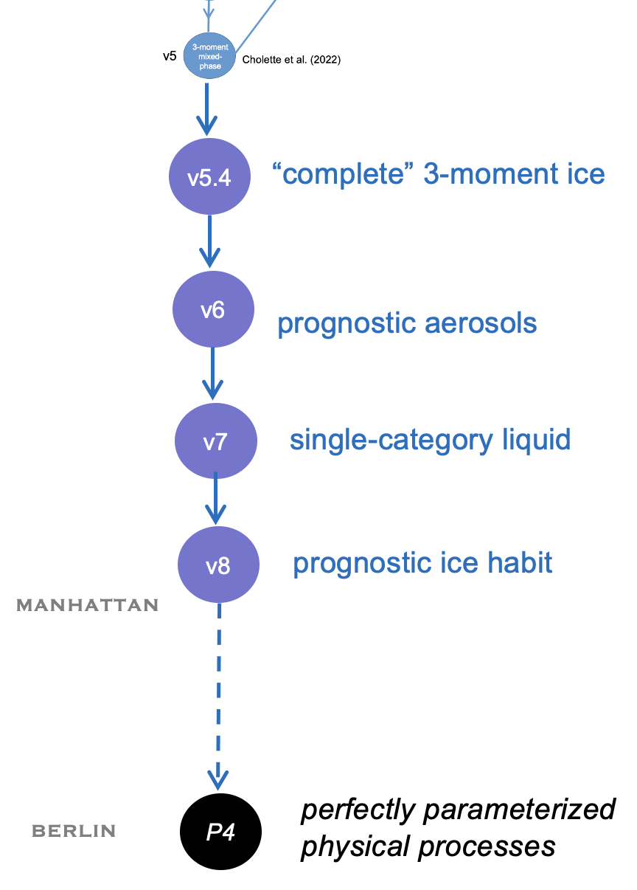
UPDATE 1: Jason Milbrandt
CURRENT
My vision of my primary research
(for the rest of my career)
CONTINUED DEVELOPMENT OF SCHEME
Complete bulk scheme “framework”
(prognostic variables, etc.)
IMPROVED PARAMETERIZED PROCESSES
(i.e. ongoing research and development)
The Holy Grail (the ultimate goal)
which we will never achieve, but must strive for

Slide 17
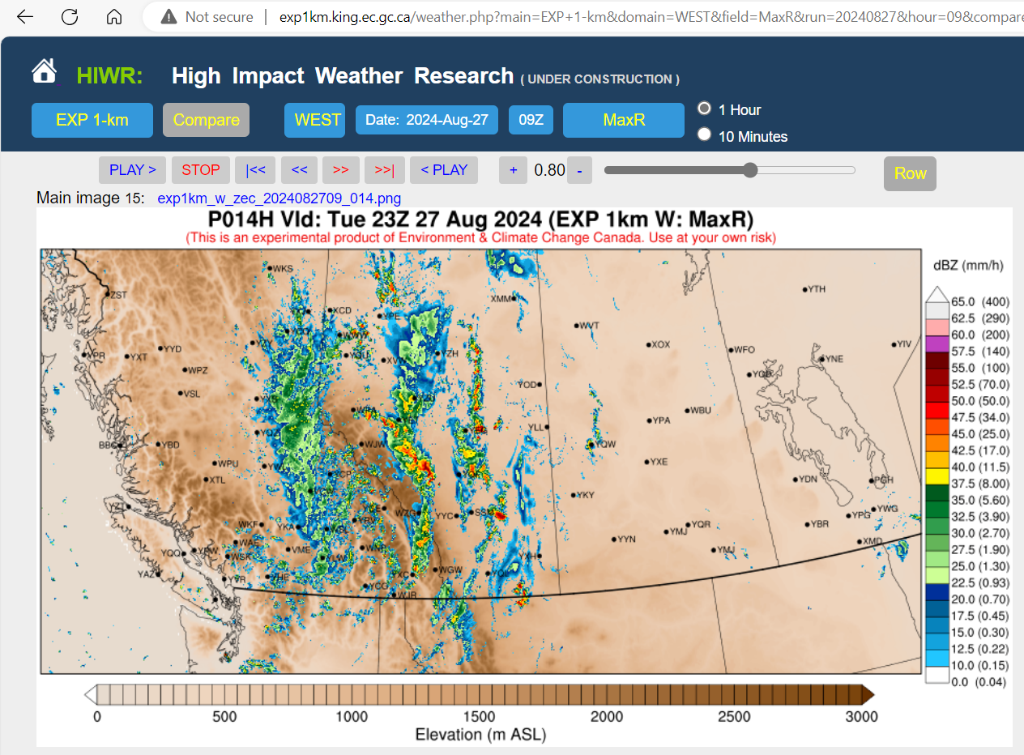
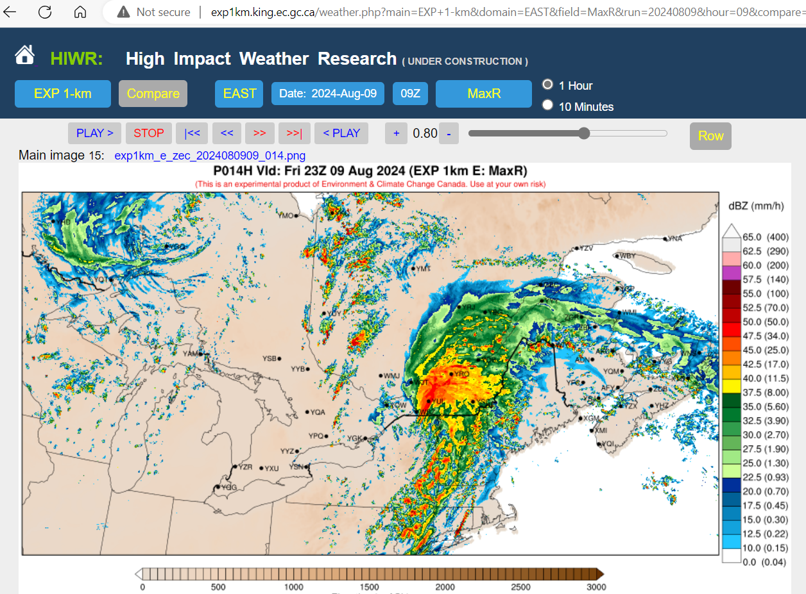
UPDATE 1: Jason Milbrandt
My 1-year plan (CP-related research towards P4)
1. Advancement of the EXP_1km system
From http://exp1km.king.ec.gc.ca/ :
From http://exp1km.king.ec.gc.ca/ :

Slide 18
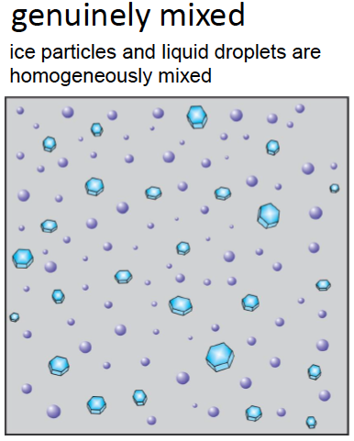
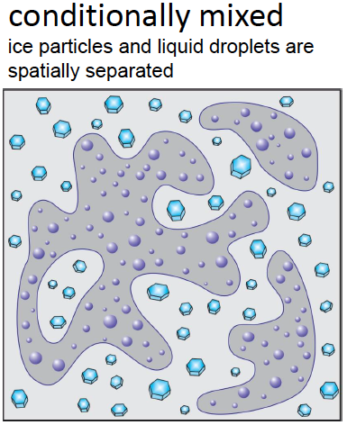
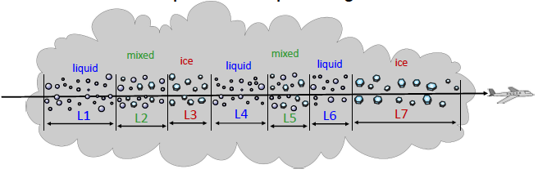
UPDATE 1: Jason Milbrandt
My 1-year plan (CP-related research towards P4)
2. Improvement to P3’s capacity to model mixed-phase clouds
NATURE
MODEL
inherently genuinely mixed*
ice and liquid are represented by hydrometeor categories with bulk quantities (e.g. mass)
Q_{i} (and N_{i}, …)
Q_{c} (and N_{c}, …)
?

Slide 19
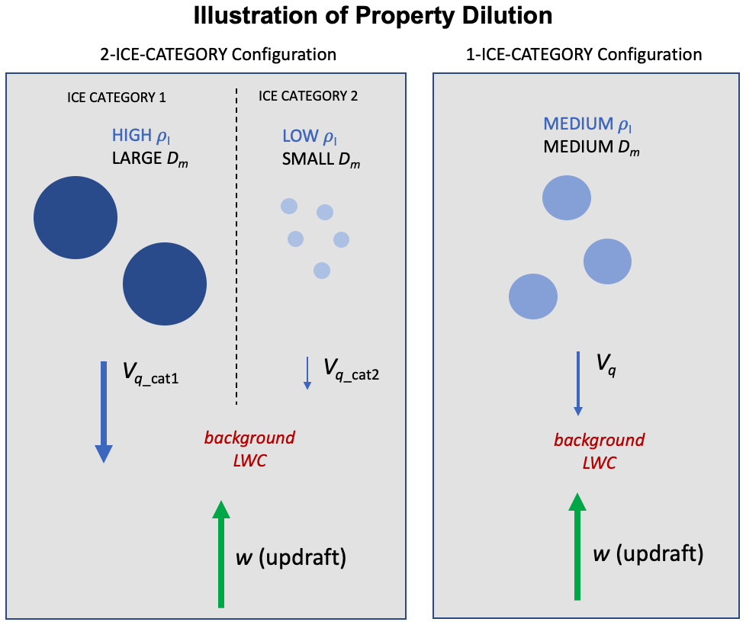
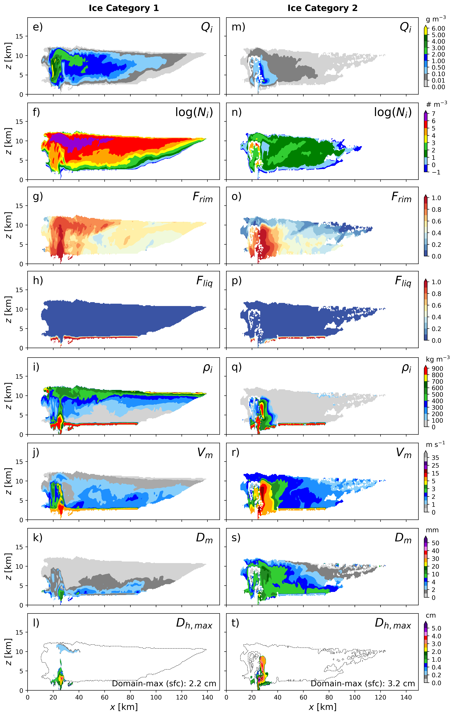
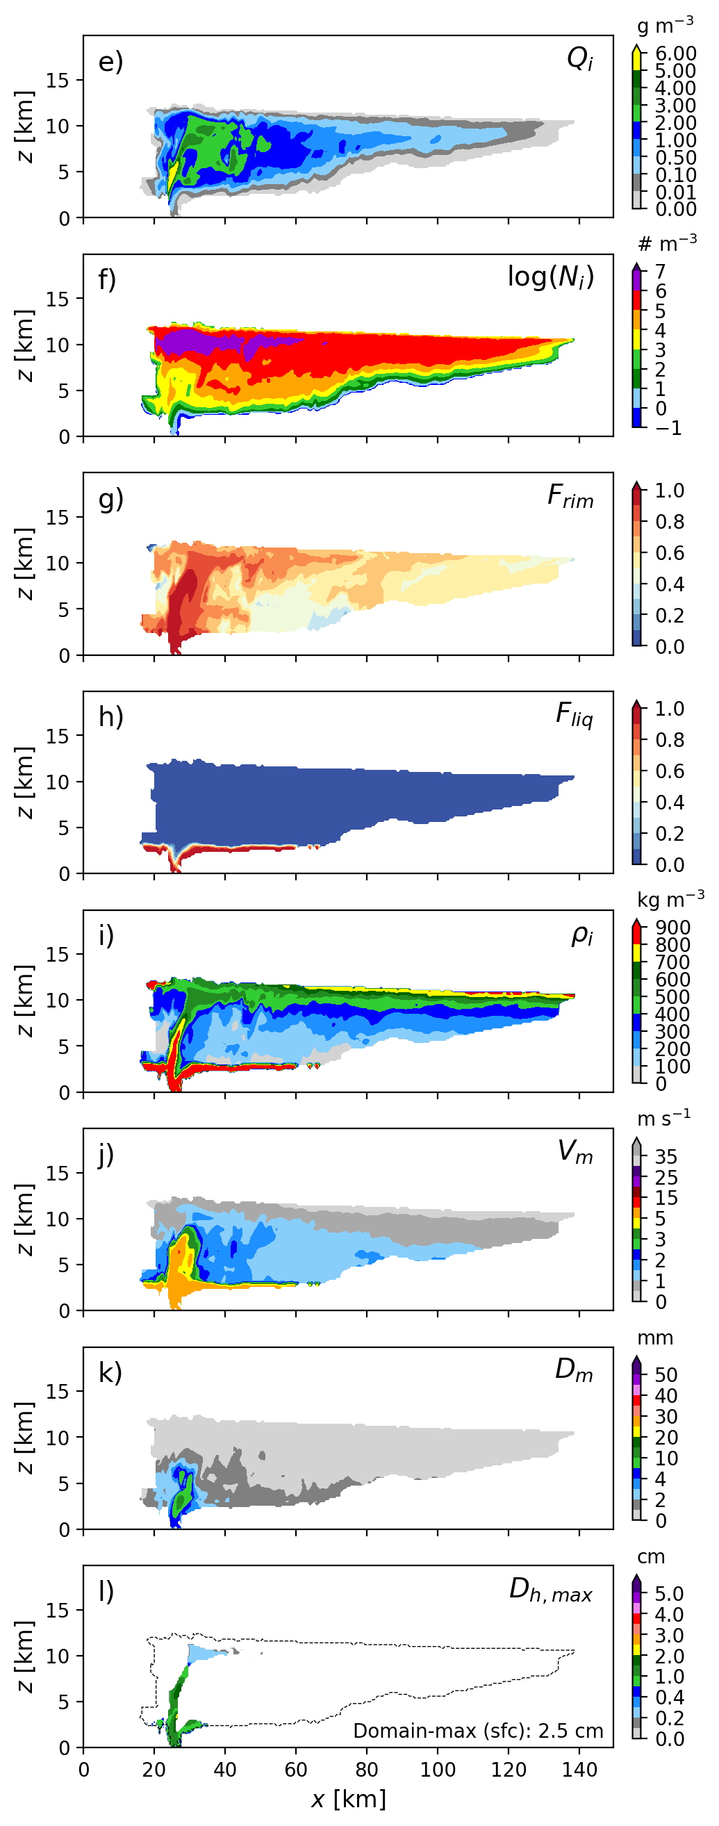
UPDATE 1: Jason Milbrandt
My 1-year plan (CP-related research towards P4)
3. Optimization of the use of multiple ice categories in P3

Slide 20
UPDATE 1: Jason Milbrandt
My 1-year plan (CP-related research towards P4)
4. On-going scheme development (towards P3_v8)
- in collaboration with Melissa and Hugh
CURRENT

Slide 21
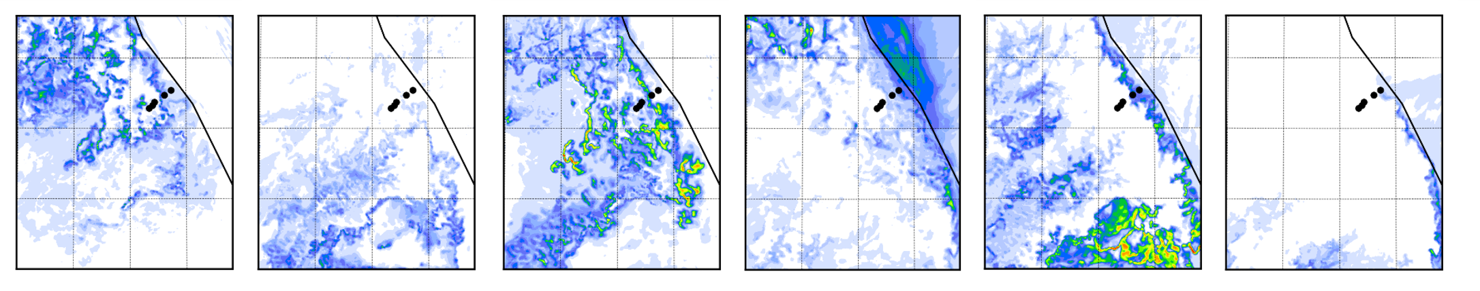
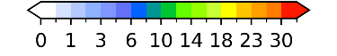
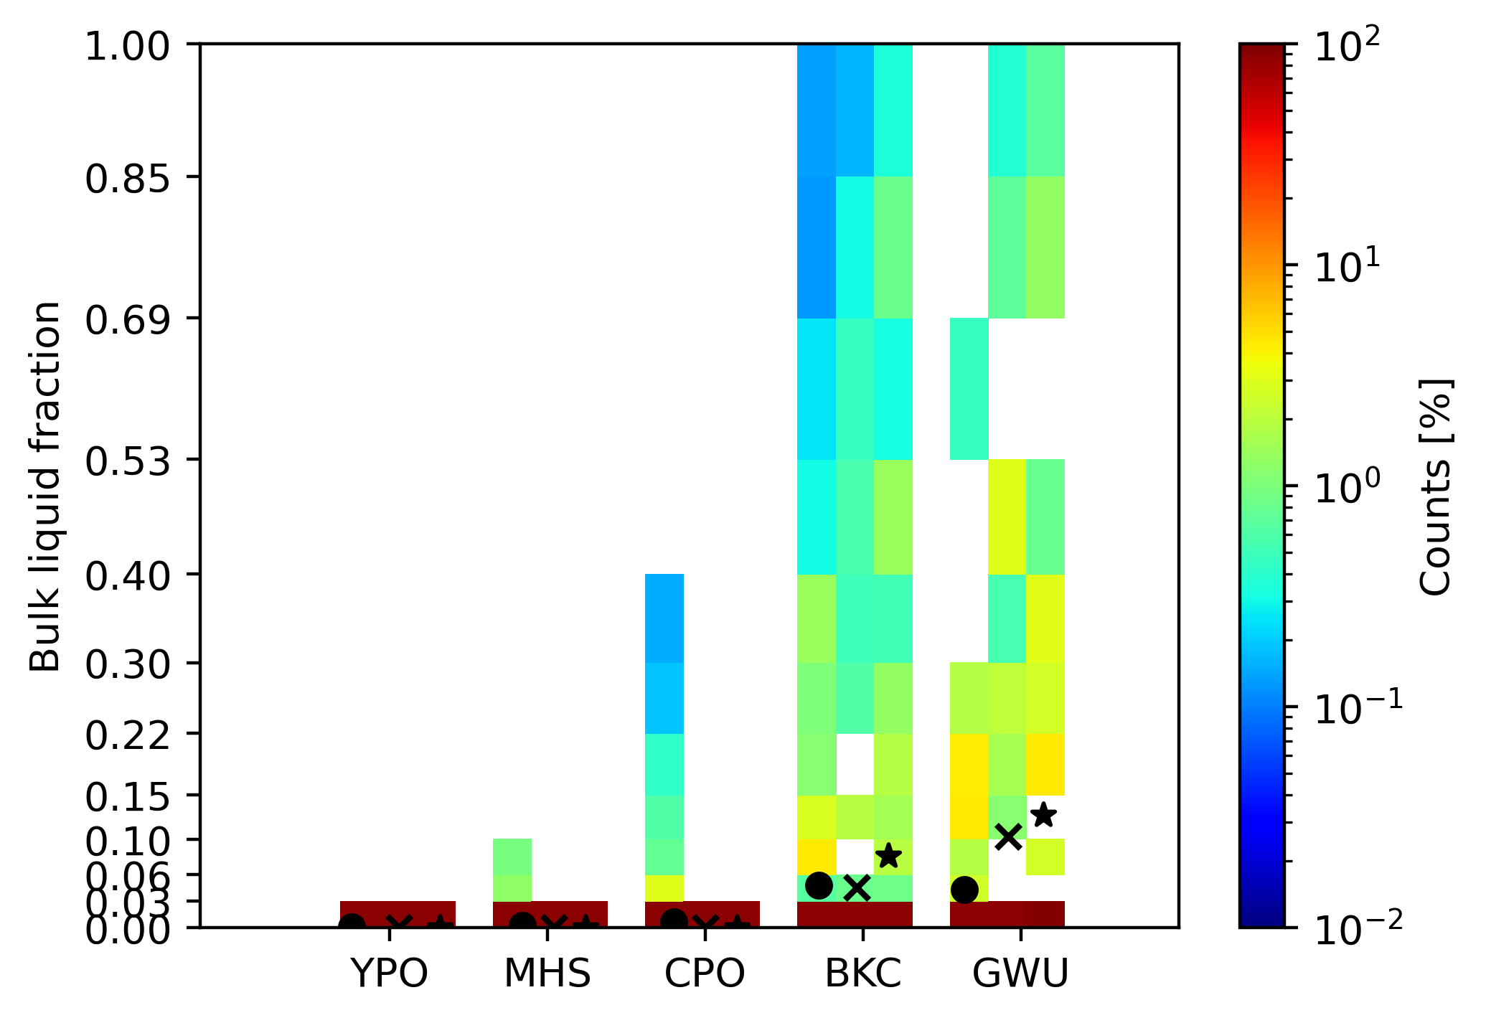
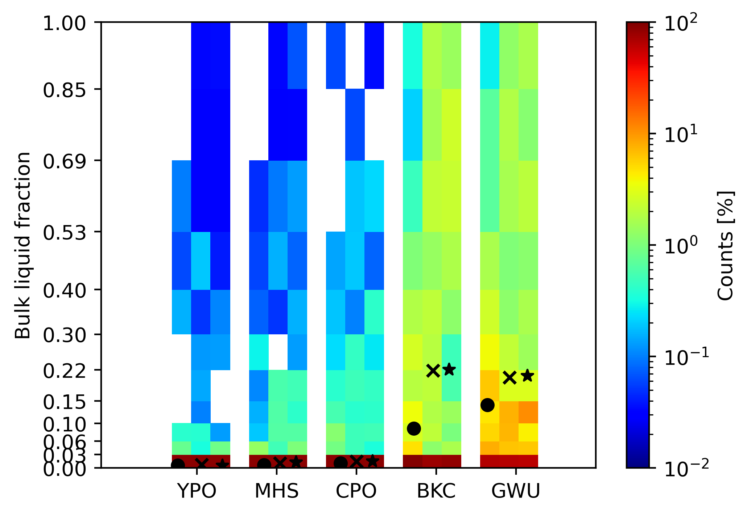
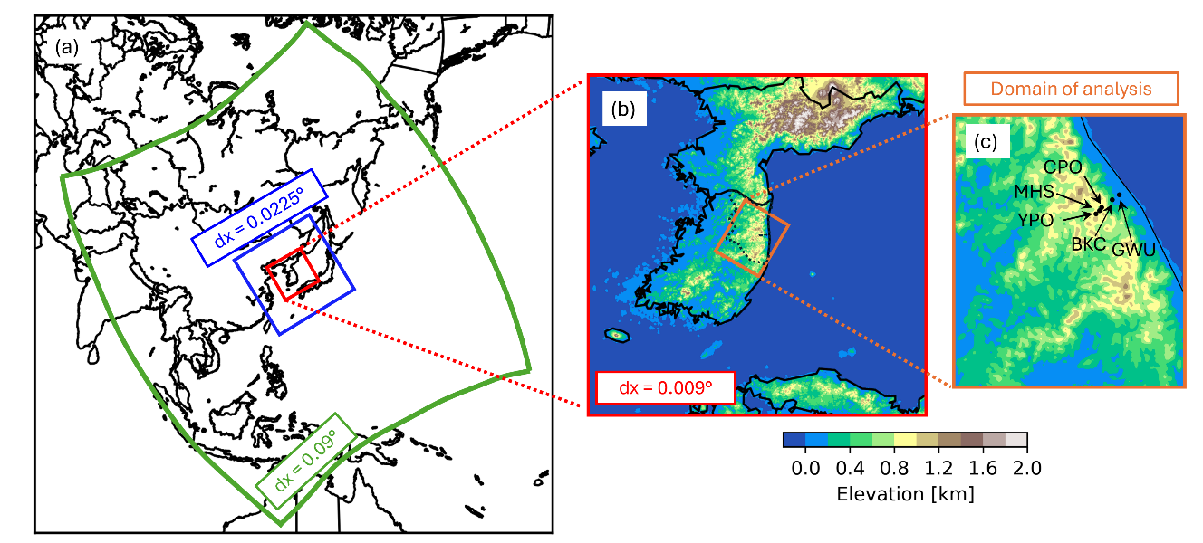
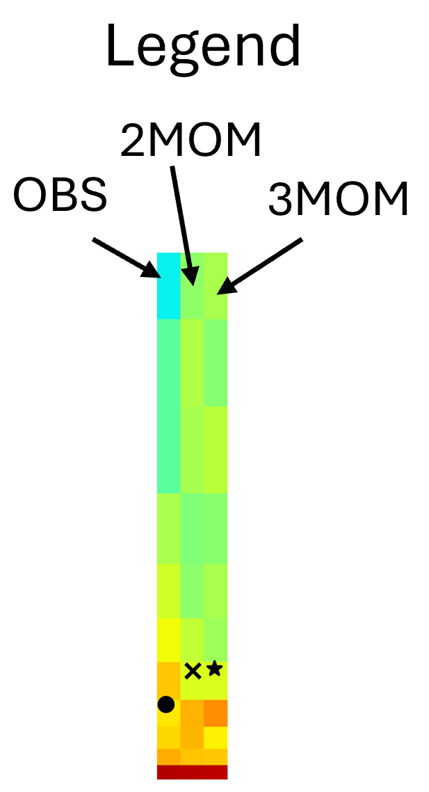
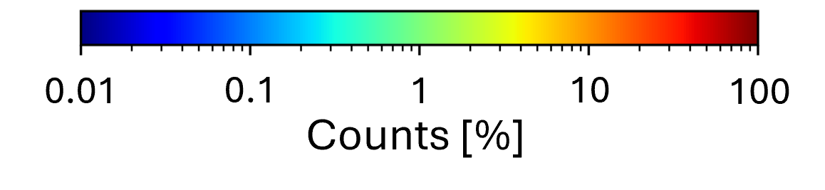
ICE-POP simulations Current research
UPDATE 2: MELISSA CHOLETTE
Objectives
To study the simulations of snow properties and
the sensitivity to 8 configurations of P3;
the impacts of horizontal resolution;
the impacts of prognostic aerosols in P3.
Results (wet snow)
Simulations (10 ICE-POP 2018 cases)
GEM* 3-domain nesting (10-km → 2.5-km → 1-km)
Wet snow acc. [mm]
4 ‘cold’ cases
6 ‘warm’ cases
Stations
Stations
OBS: Chang et al., (2024)

Slide 22
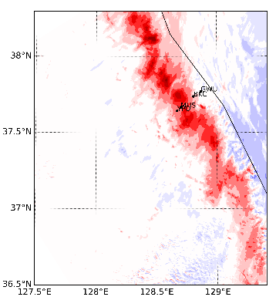
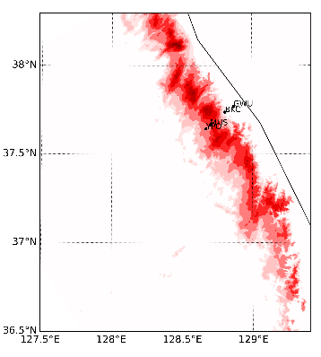
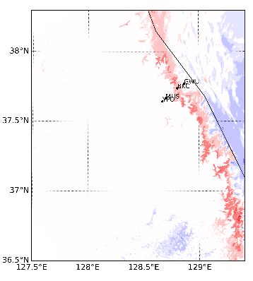
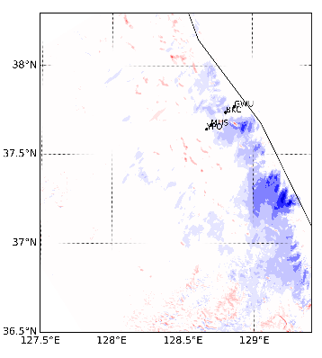
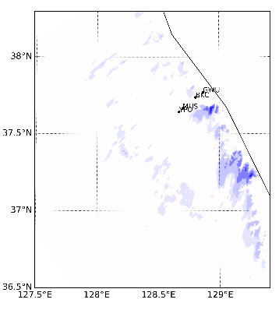
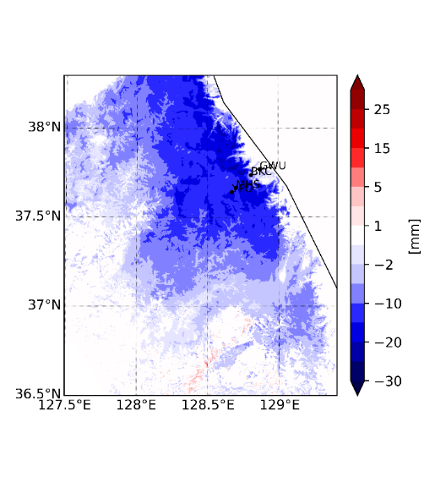
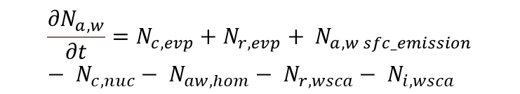
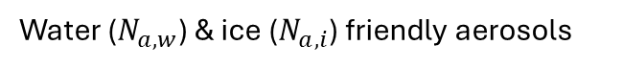
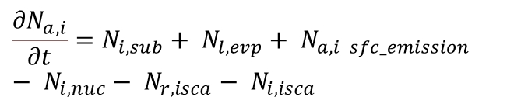
P3_aerosols development Upcoming research
UPDATE 2: MELISSA CHOLETTE
Objectives
To prognose aerosols mixing ratio instead of holding it constant in time and space during simulations to study
Cloud and precipitation microphysics
Polluted transport and radiation interaction
Results (precipitation types)
P3_aerosols – P3 (1 ICE-POP case)
Total
Freezing Rain
Rain
P3 modifications
Initialization with monthly mean climatology
2 new prognostic equations in P3
Water ($N_{a,w}$) & ice ($N_{a,i}$) friendly aerosols
Solid
Graupel
$${\frac{{∂N}_{a,w}}{∂t}=N}_{c,evp}+N_{r,evp}+ N_{a,w sfc_emission}− N_{c,nuc}− N_{aw,hom}− N_{r,wsca}− N_{i,wsca}$$
$${\frac{{∂N}_{a,i}}{∂t}=N}_{i,sub}+ N_{l,evp}+ N_{a,i sfc_emission}− N_{i,nuc}− N_{r,isca}− N_{i,isca}$$

Slide 23
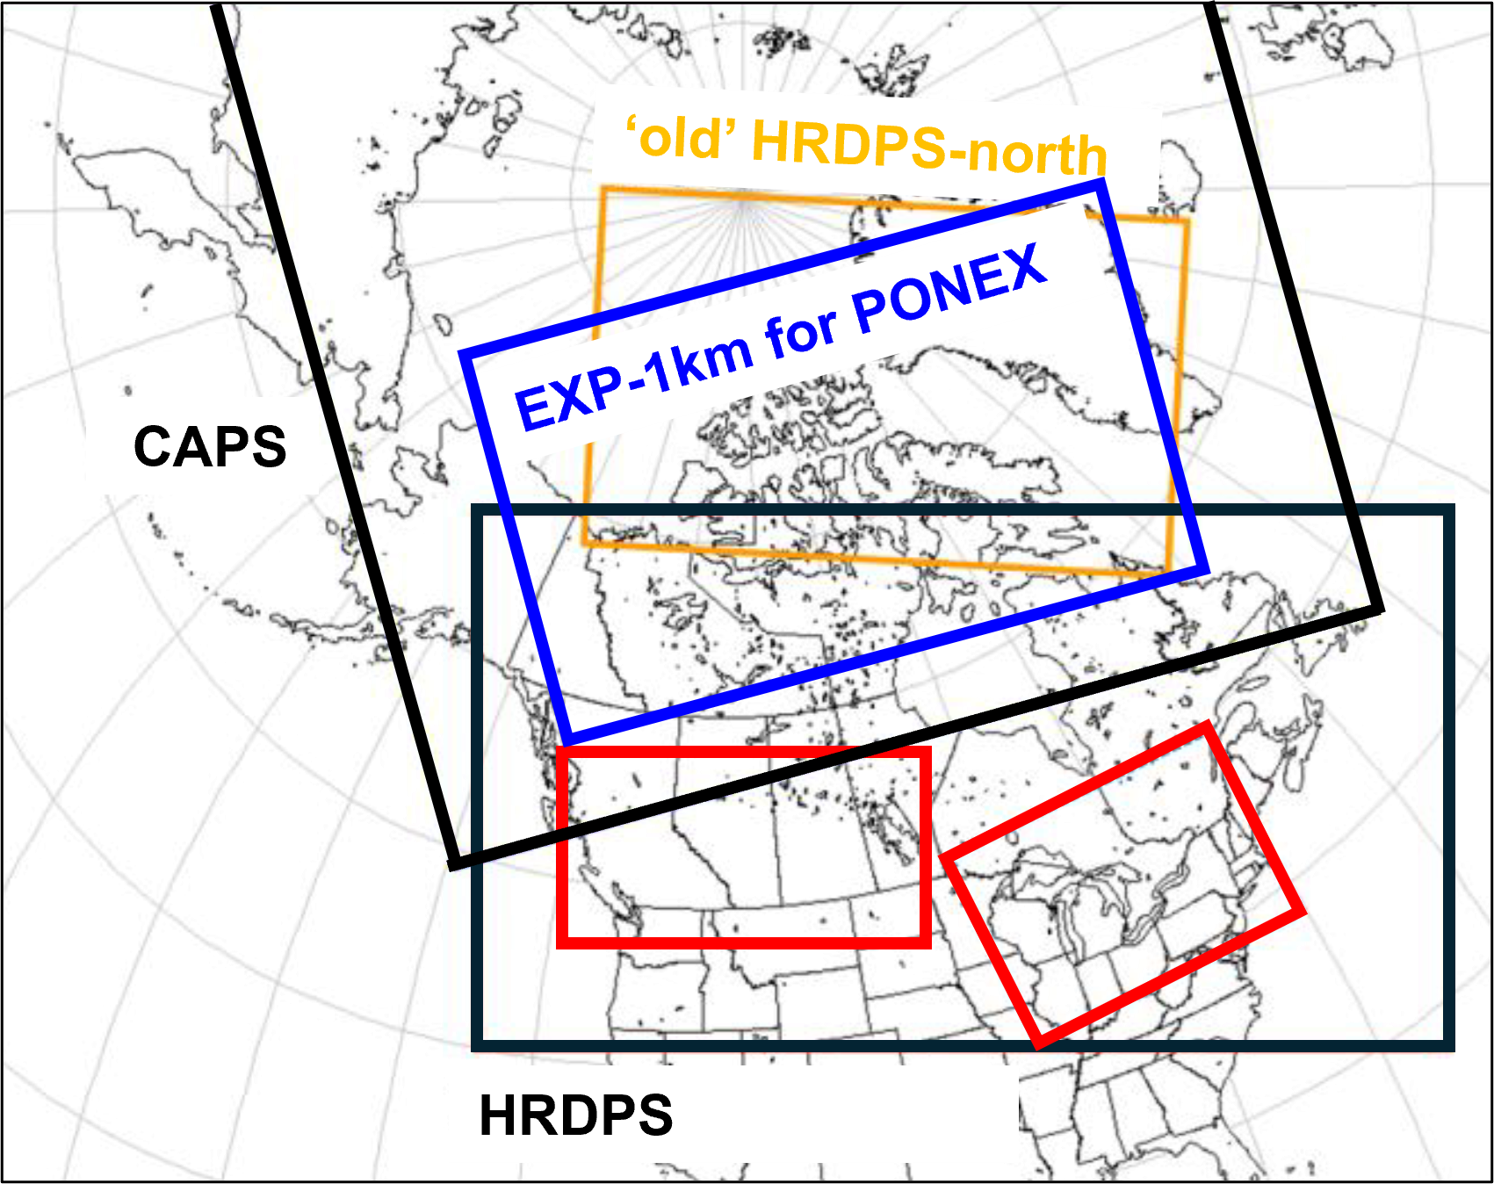
EXPs-1km – Modelling research during PONEX Upcoming research
UPDATE 2: MELISSA CHOLETTE
Objectives
CAPS*-based “in-house” real-time simulations evaluated with PONEX data to study:
Cooling and drying anomalies during polar night (radiative transfer)
Microphysics of clouds: Thin ice clouds, mixed-phase clouds, primary nucleation, secondary ice production…
Impacts of polluted (P3_aerosols) transport
… other projects ???
Simulations design
Who’s interested to meet with CAPS group on 5 February between 2pm-3pm ET?
EXP-1km (WEST and EAST)
https://hpfx.collab.science.gc.ca/~rum001/exp_1km/exp_1km_w/current/index.html
*CAPS is for the Canadian Arctic Prediction System

Slide 24
UPDATE 3: ZEN MARIANI
To be populated…

Slide 25
UPDATE 4: etc…
To be populated…

Slide 26
AGENDA
Introductory comments
Cloud Physics research program overview document
Individual presentations -- who is doing what
Discussion of future meeting format

Slide 27
PROPOSED CP MEETING FORMAT
Meet bi-weekly (or every 3 weeks)
Duration: 90 min
Typical agenda:
Business (e.g. CP overview document, announcements, etc.)
Individual research updates (5-15 min)
Last 30 min (attendance optional): Mini seminars
Tentative decisions from group
(and we will play this by ear)

